Slide 1

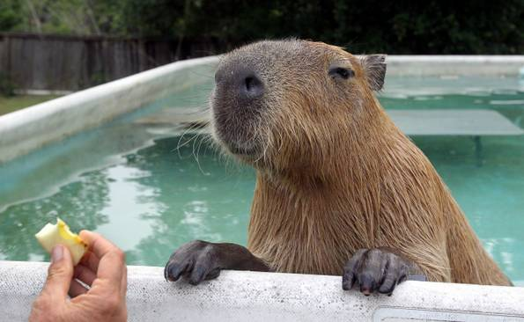
Introducing Cucumber and Capybara
Engineering Software as a Service §7.6
Notes:
Cucumber turns customer-understandable user stories into acceptance tests and integration tests

Slide 2
User stories To Acceptance Tests?
Wouldn't it be great to automatically map 3x5 card user stories into tests for user to decide if accept the app?
How would you match the English text to test code?
How could you run the tests without a human in the loop to perform the actions?

Slide 3
Cucumber: Big Idea
Tests from customer-friendly user stories
Acceptance: ensure satisfied customer
Integration: ensure interfaces between modules consistent assumptions, communicate correctly.
Cucumber meets halfway between customer and developer
User stories not code, so clear to customer and can be used to reach agreement
Also not completely freeform, so can connect to real tests
Notes:
Cucumber turns customer-understandable user stories into acceptance tests, which insure the customer is satisfied, and integration tests, which ensure that the interfaces between modules have consistent assumptions and communicate correctly

Slide 4
Example User Story
1 Feature
Feature: User can manually add movie
Scenario: Add a movie
Given I am on the RottenPotatoes home page
When I follow "Add new movie"
Then I should be on the Create New Movie page
When I fill in "Title" with "Men In Black"
And I select "PG-13" from "Rating"
And I press "Save Changes"
Then I should be on the RottenPotatoes home page
And I should see "Men In Black"
≥1 Scenarios / Feature
3 to 8 Steps / Scenario
Notes:
Cucumber combines a feature that you want to add with a set of scenarios - this is called a user story
Features usually have many scenarios

Slide 5
Cucumber User Story, Feature, and Steps
User story: typically maps to one feature
Feature: ≥1 scenarios that show different ways a feature is used
Keywords Feature and Scenario identify respective components
both happy path and sad path scenarios
Scenario: typically 3 - 8 steps
Step definitions: Ruby code to test steps
features/step_definitions/*_steps.rb

Slide 6
5 Step Keywords
Given steps represent state of world before event: preconditions
When steps represent event
ex: simulate user pushing a button
Then steps represent expected postconditions; check if true
And and But extend previous step
These are all aliases for same method
Notes:
Given identifies the current state
When identify the action
Then to identify the consequences of the action

Slide 7
Steps => Step Definitions via Regular Expressions
Regexes match English phrases in steps of scenarios to step definitions
Given /^(?:|I )am on (.+)$/
“I am on the Rotten Potatoes home page”
Step definitions (Ruby code) likely use captured string
“the Rotten Potatoes home page”
Notes:
Cucumber matches steps to set definitions using regular expressions

Slide 8
Fake User to try Scenarios?
Tool that pretends to be user to follow scenarios of user story
Capybara simulates browser
Can interact with app to receive pages
Parse the HTML
Submit forms as a user would
Notes:
Replaced WebRat
Rat size of Dog

Slide 9
From Red to Green
cucumber filename to run one feature, rake cucumber runs all
Green for passing steps
Yellow for not yet implemented
Red for failing , any steps following are Blue
Goal: Make all steps green to pass
Notes:
Cucumbers are green hence the name of tool

Slide 10
Setting up Cucumber and Capybara
Cucumber is suppled as a Ruby gem, so we first need to declare that our app depends on this gem and use Bundler to install it
Steps
Add Cucumber to GEM File: https://gist.github.com/armandofox/c4d6569960f133101720
Run bundle install --without production
Set up the directories using cucumber’s generator. In the app’s root directory:
rails generate cucumber:install capybara
rails generate cucumber_rails_training_wheels:install
Initialize the test database
bundle exec rake db:test:prepare
Notes:
This will give us commonly used step definitions as a starting point
located in myrottoenptoatoes/features/step_defintions/web_steps.rb
Before running Cucumber we need to initialize the test database
This needs to be done the first time you run tests or whenever the database schema is changed

Slide 11
Demo
Add feature to cover existing functionality
Note: This example is doing it in wrong order – should write tests first
Just done for pedagogic reasons
Watch screencast: https://www.youtube.com/watch?v=-wgZXDmhRw4&list=WL&index=4
Notes:
Mention preconditions, actions, postconditions
Create .feature file (Addmovie.feature)
Tells you want to do
Copies the error message name
Find route via rake route
Have terminal windows already open for
1) In rottenpotatoes
2) Addmovie.feature in editor in features directory
3) paths.rb in editor in features/support directory
Go to VM, tab show feature going to try to run with Cuke
Go to Tab to run Cuke on AddMovie.feature
Note error message, copy the missing page
Go to routes.rb to edit
when /^the RottenPotatoes home page/
Go to rake routes to find index mapping
'/movies'
Try again
Note error message, copy the missing page
Go to routes.rb to edit
﻿ when /^the Create New Movie page/
Go to rake routes to find new mapping
'/movies/new'
Try again – all should pass

Slide 12
Enhancing Rotten Potatoes
Engineering Software as a Service §7.8
© 2013 Armando Fox & David Patterson, all rights reserved

Slide 13
Integrated with The Movie Database (TMDb)
New Feature: Populate from TMDb, versus enter information by hand
Need to add ability to search TMDb from Rotten Potatoes home page
Need LoFi UI and Storyboard

Slide 14
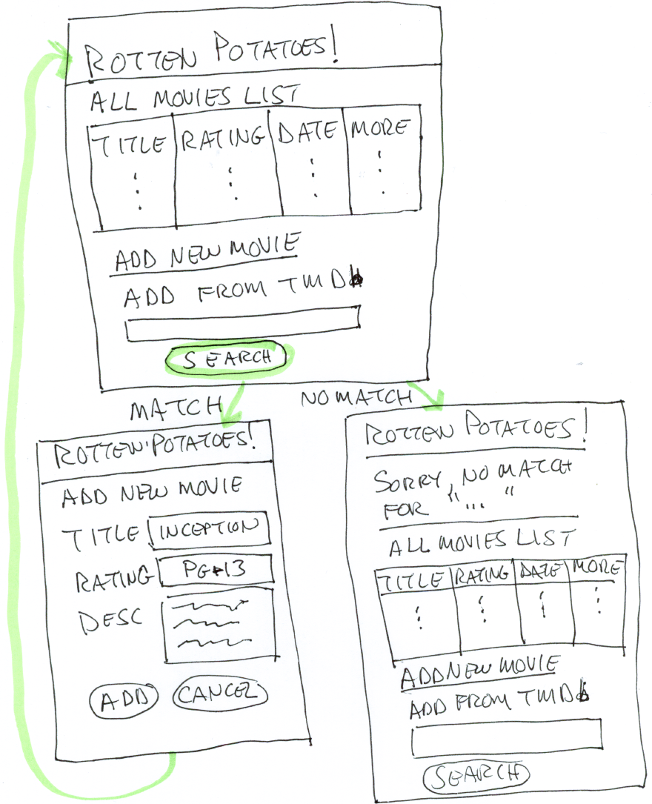
Storyboard TMDb
Notes:
The home page of Rotten Potatoes, which lists all movies, will be augmented with a search box where we can type some title keywords of a movie and a “Search” button that will search TMDb for a movie whose title contains those keywords.
If the search does match—the so-called “happy path” of execution—the first movie that matches will be used to “pre-populate” the fields in the Add New Movie page that we already developed
If the search doesn’t match any movies—the “sad path”—we should be returned to the home page with a message informing us of this fact. Easy Story Board

Slide 15
Search TMDb User Story
Feature: User can add movie by searching in The Movie Database (TMDb)
As a movie fan
So that I can add new movies without manual tedium
I want to add movies by looking up their details in TMDb
Scenario: Try to add nonexistent movie (sad path)
Given I am on the RottenPotatoes home page
Then I should see "Search TMDb for a movie"
When I fill in "Search Terms" with "Movie That Does Not Exist"
And I press "Search TMDb"
Then I should be on the RottenPotatoes home page
And I should see "'Movie That Does Not Exist' was not found in TMDb."
https://gist.github.com/armandofox/6a08923c2c0c04c6c1f0
Notes:
Usually start with happy path; but we’d have to implement method for searching and matching TMDb, which we’ll do in next chapter.
Have to explain both BDD and TDD, so we’ll do BDD first – so don’t do sad path
Instead, do a sad path where can’t find it, and put in dummy method that always fails to find, which makes sad path work.
BDD next will go further in TDD to build the method you need. Not a good idea, but works for this chapter. In future, will go back and forth between BDD design and TDD implementation
File: /myrottenpotatoes/features/AddTMDbSearch.feature
Once added run: cucumber features/AddTMDbSearch.feature

Slide 16
Haml for Search TMDb page
-# add to end of app/views/movies/index.html.haml:
%h1 Search TMDb for a movie
= form_tag :action => 'search_tmdb' do
%label{:for => 'search_terms'} Search Terms
= text_field_tag 'search_terms'
= submit_tag 'Search TMDb'
https://gist.github.com/armandofox/e9125584f9f08ece12a3
Notes:
We will need a new view to go with new UI, and then include a form to fill in
1st line is search movie. Need to make a name for the action, we’ll call it “search_tmdb”
Label is form where fill in the information for movie when it does match
Line 3: %h1 Search TMDb for a movie is the text that allows Then I should see “Search TMDb for a movie” to pass.
As with any user interaction in a view, we need a controller action that will handle that Web interaction.
In this case the interaction is submitting the form with search keywords.
Line 5 = form_tag :action => 'search_tmdb' do says that when the form is submitted, the controller action search_tmdb will receive the form submission.

Slide 17
Haml expansion last 2 lines
This Haml:
= text_field_tag 'search_terms'
= submit_tag 'Search TMDb’
Turns into this HTML:
<label for='search_terms'>Search Terms</label>
<input id="search_terms" name="search_terms" type="text" />
Notes:
The key is that the for attribute of the label tag matches the id attribute of the input tag, which was determined by the first argument to the text_field_tag helper called in line 8 of Figure 7.8.
This correspondence allows Cucumber to determine what form field is being referenced by the name “Search Terms” in line 11 of Figure 7.7: When I fill in “Search Terms”. . . .

Slide 18
Try Cucumber?
If try Cucumber, it fails
Missing the route
Also MoviesController#search_tmdb is controller action that should receive form, yet not in movies_controller.rb
Should use Test Driven Development (future lecture) to implement method search_tmdb
Instead, to finish sad path, add fake controller method that always fails

Slide 19
Trigger Fake Controller when form is POSTed
# add to routes.rb, just before or just after 'resources :movies' :
# Route that posts 'Search TMDb' form
post '/movies/search_tmdb'
https://gist.github.com/b24fdecfd84e1cb55d34FrfkF6pd
Notes:
we have to make sure there is a route to this new controller action.
Above is the line you must add to config/ routes.rb to add a form submission (POST) route to that action

Slide 20
Fake Controller Method: Will Fail Finding Movie
# add to movies_controller.rb, anywhere inside
# 'class MoviesController < ApplicationController':
def search_tmdb
# hardwired to simulate failure
flash[:warning] = "'#{params[:search_terms]}' was not found in TMDb."
redirect_to movies_path
end
https://gist.github.com/79e81a88806b477a4f36
Notes:
For now, use fix It to fail, which let’s us complete the sad path.
This “fake” controller method always behaves as if no matches were found.
It retrieves the keywords typed by the user from the params hash (as we saw in Chapter 3), stores a message in the flash[], and redirects the user back to the list of movies.
Recall from Chapter 3 that we added code to app/views/layouts/application.html.haml to display the contents of the flash on every view.

Slide 21
Happy Path of TMDb
Find an existing movie, should return to Rotten Potatoes home page
But some steps same on sad path and happy path
How make it DRY?
Background means steps performed before each scenario

Slide 22
TMDb with 2 Scenario: Background
Feature: User can add movie by searching for it in The Movie Database (TMDb)
As a movie fan
So that I can add new movies without manual tedium
I want to add movies by looking up their details in TMDb
Background: Start from the Search form on the home page
Given I am on the RottenPotatoes home page
Then I should see "Search TMDb for a movie”
https://gist.github.com/d145eca7452b5a3e5e23
Notes:
DRYing out the common steps between happy and sad paths using the Background keyword
The Cucumber Background command shows the steps that should be run before any other scenarios of a feature are run,
Add this to the features/search_tmdb.feature to this and run cucumber features/search_tmdb.feature
This will fail.
We will develop the controller in the next chapter

Slide 23
Cucumber Summary
New feature => UI for feature, write new step definitions, even write new methods before Cucumber can color steps green
Usually do happy paths first
Background lets us DRY out scenarios of same feature
BDD/Cucumber test behavior; TDD/RSpec in folllowing chapter is how write methods to make all scenarios pass

Slide 24
Explicit vs. Implicit and Imperative vs. Declarative Scenarios
Engineering Software as a Service §7.9

Slide 25
Types of Scenarios
Are all requirements directly from the User Stories?
Scenarios should have 3 to 8 steps - is there a way to keep them closer to 3 than to 8?

Slide 26
Explicit vs. Implicit Scenarios
Explicit requirements usually part of acceptance tests
Likely explicit user stories and scenarios: list movies
Implicit requirements are logical consequence of explicit requirements, typically integration testing
Movies listed in chronological order or alphabetical order?

Slide 27
Imperative vs. Declarative Scenarios
Imperative: Initial user stories with many steps, specifying logical sequence to desired result
Not-DRY if many user stories imperative
Declarative: describe state, not sequence
Fewer steps
Example Feature: movies should appear in alphabetical order, not added order
Example Scenario: view movie list after adding 2 movies

Slide 28
Example Imperative Scenario
Given I am on the RottenPotatoes home page
When I follow "Add new movie"
Then I should be on the Create New Movie page
When I fill in "Title" with "Zorro"
And I select "PG" from "Rating"
And I press "Save Changes"
Then I should be on the RottenPotatoes home page
When I follow "Add new movie"
Then I should be on the Create New Movie page
When I fill in "Title" with "Apocalypse Now"
And I select "R" from "Rating"
And I press "Save Changes"
Then I should be on the RottenPotatoes home page
When I follow ”Movie Title"
Then I should see "Apocalypse Now" before "Zorro"
Only step specifying behavior;
Rest are implementation. But BDD specifies behavior, not implementation!

Slide 29
Domain Language
Declarative as if making domain language
Uses terms and concept of app
Informal language
Declarative steps describe the state app should be in
Imperative: sequence of steps to change current state into desired state

Slide 30
Example Declarative Scenario
Feature: movies when added should appear in movie list
Scenario: view movie list after adding movie (declarative and DRY)
Given I have added "Zorro" with rating "PG-13"
And I have added "Apocalypse Now" with rating "R"
Then I should see "Apocalypse Now" before "Zorro" on the Rotten Potatoes home page
3 steps vs. 15 steps: 2 to set up test,
1 for behavior
Declarative scenarios focus attention on feature being described and tested vs. steps needed to set up test
What about new step definitions?

